Slide 1
ECONOMIC AND DEMOGRAPHIC TRENDS ANALYSIS
GURUPRASATH K

Slide 2
Project Overview
The project will provide a comprehensive analysis of the economic and demographic changes that have shaped the global landscape over the last several decades. It will also offer actionable insights, such as potential future trends or areas where policy or investment might be needed.
Data Source
Excel
SQL
Statistics
Power Bi

Slide 3
Data Cleaning
Replaced null values as Zero’s.
Removed Duplicate Rows.
Removed Blank Rows and Columns.
Appended GDP dataset.
Unpivoted Years and values.

Slide 4
Statistics
Population Data
GDP Analysis
Infant Mortality
Literacy Rates
Growth Trends

Slide 5
DAX Function
population growth rate over time
GDP growth rate.
calculated columns for GDP per capita.
Aggregating population or GDP data by region
Deriving insights such as the correlation between literacy rates and GDP.

Slide 6
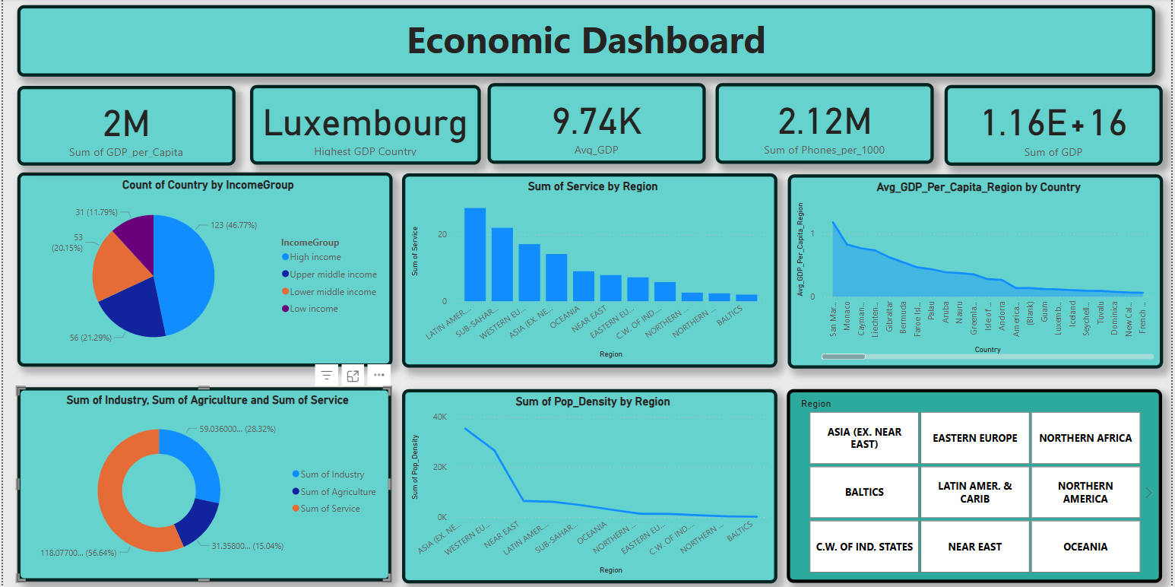
Dashboard

Slide 7
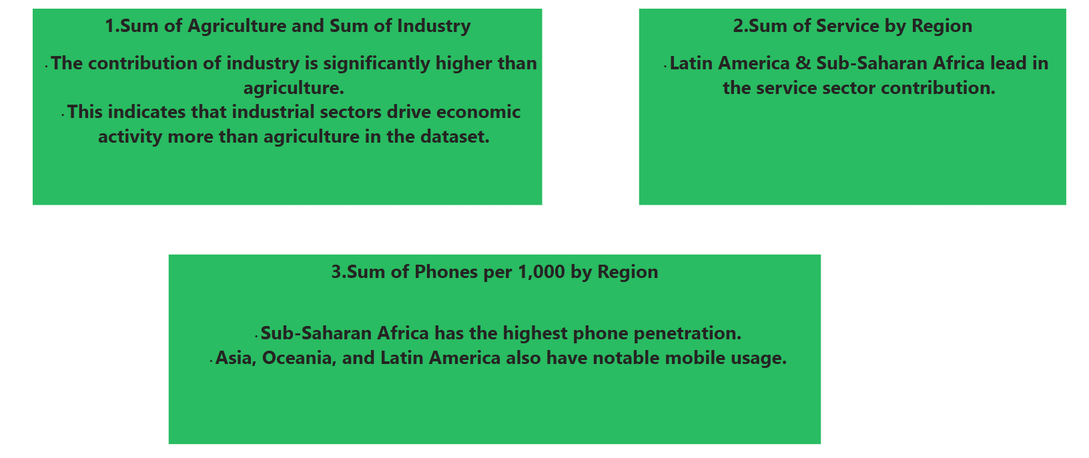
Insights

Slide 8
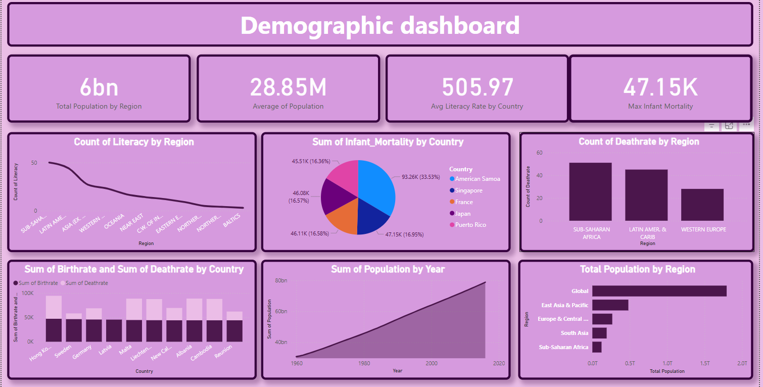
Dashboard-2

Slide 9
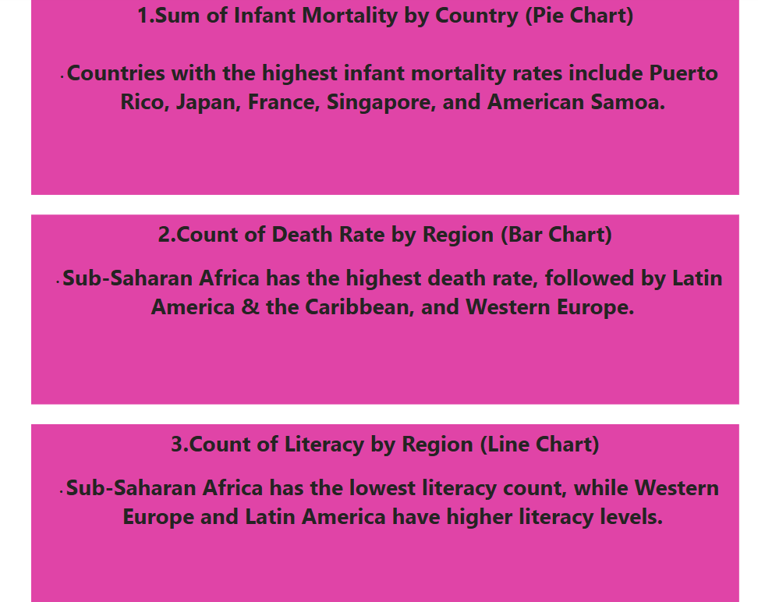
Insights

Slide 10
THANK YOU

